Slide 1
AIR QUALITY PREDICTION USING MACHINE LEARNING
Hruthik Vinnakota, Maria Hovhannisyan, Sahanti Samarth Zade, Shubham Singh, and Utsav Rastogi.

Slide 2
ABSTRACT
Air pollution is a serious issue in cities like Beijing
This study analyzed air quality data from 2013 to 2017 to find the pollutants with the most impact on air quality
PM10 had the strongest correlation with PM2.5
Temperature, wind speed, and pressure were identified as additional factors influencing air quality
A machine learning model achieved 94% accuracy in predicting air quality

Slide 3
INTRODUCTION
Air pollution is a major environmental issue in Beijing. This study examines the correlation between pollutants and PM2.5 levels in the city, and identifies key factors affecting air quality. Machine learning is used to predict PM2.5 levels, and the findings can aid in developing strategies to reduce air pollution and improve public health.

Slide 4
OBJECTIVE
This project examines air quality data and develops a machine learning model to estimate PM2.5 levels, aiming to improve understanding of air quality and its impact on health.

Slide 5
THEORETICAL BACKGROUND
Theoretical Concepts & background of the problem will be discussed here
Definition of the problem | To identify key factors impacting air quality and develop an ML model to estimate PM2.5 levels and improve air quality.
The theoretical background of the problem | The research aims to create a model that estimates PM2.5 levels using AQI as a predictor variable to help policymakers develop effective strategies to improve air quality.
Solution of the problem | To improve air quality and human health by identifying trends and providing insights to reduce air pollution through efficient planning.
Why our solution is better | The study uses advanced techniques to evaluate the effectiveness of the machine learning model and derives valuable insights from its features. It focuses on the Beijing region's reliable data across different time frames.

Slide 6
METHODOLOGY

Slide 7
METHODOLOGIES
Data Collection
Data Cleaning and Pre- Processing
gathering and storing information
Preparing the raw data for models by removing any errors, or missing values, & transforming the data into a format suitable for analysis.
Exploratory Data Analysis
Data Pre-Processing
(EDA) involves the use of statistical and visualization techniques to know about the dataset
involves transforming the raw data into a format for analysis and ML models, including tasks such as cleaning, normalization, scaling, and feature engineering.

Slide 8
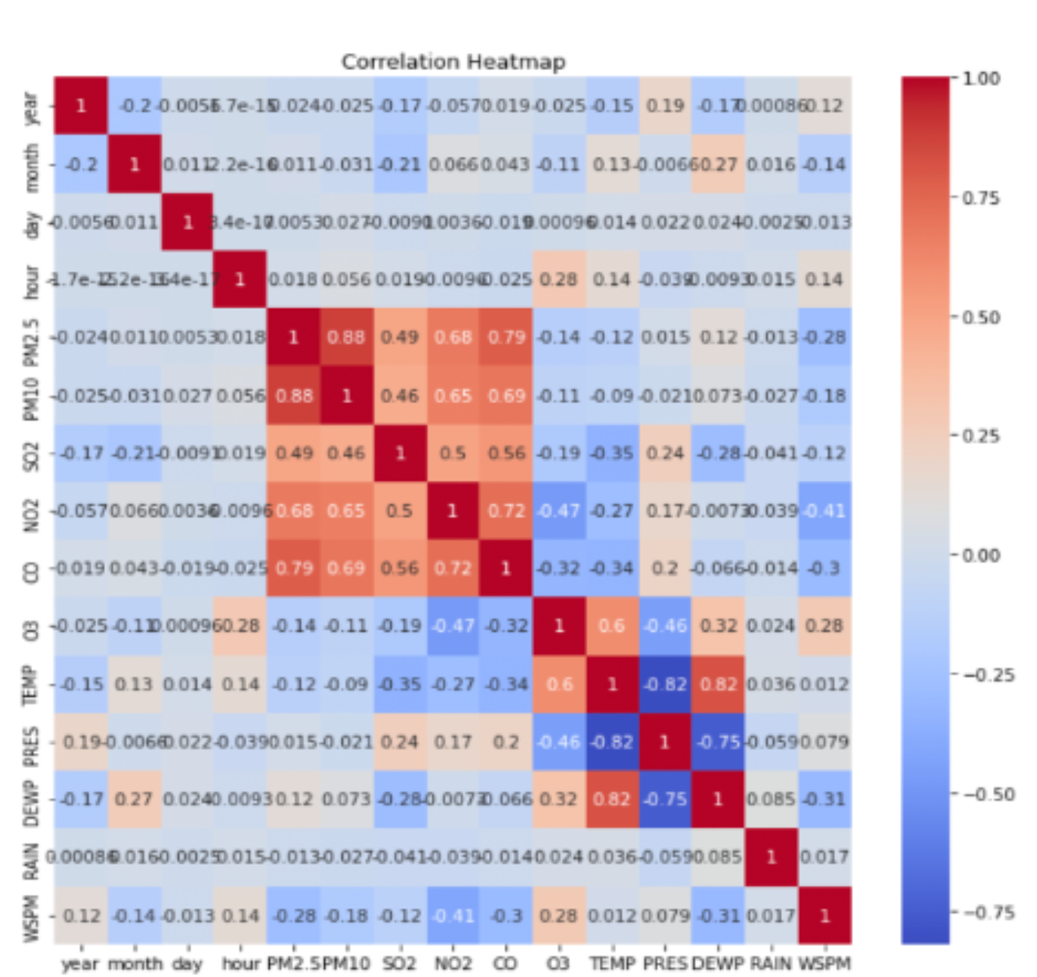
THE CORRELATION HEATMAP
The Correlation Heatmap of features in the paper shows the correlation between the target variable PM2.5 and the feature variables.
It was observed that PM2.5 had a high correlation with columns CO, NO2, and PM10.
Therefore, the paper suggests that these pollutants have the most significant impact on declining air quality in Beijing
The heatmap was used to identify the key factors influencing air quality in the region.

Slide 9
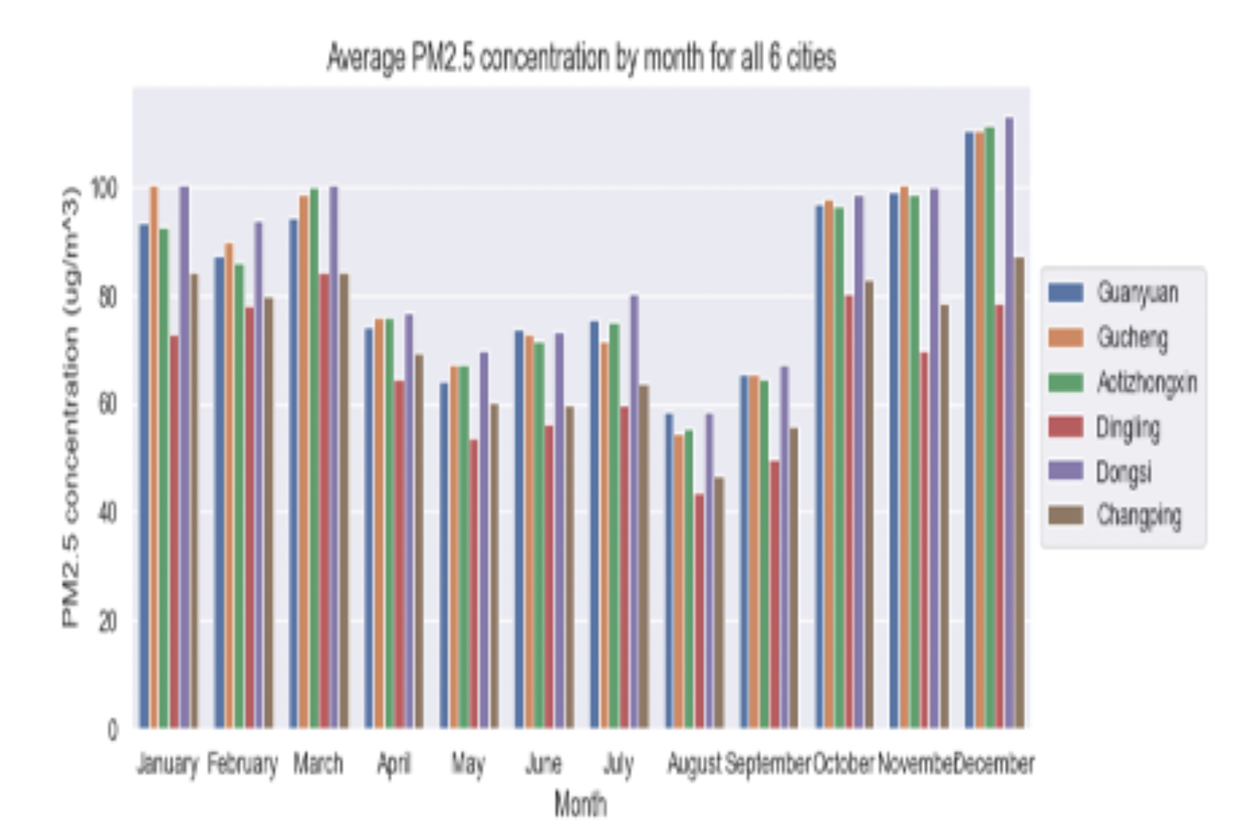
AVG PM2.5 CONCENTRATION BY MONTH-WISE
Data was analyzed to determine the average PM2.5 concentration in various cities.
The figure represents the average concentration in different months of the year.
December had the highest concentration of PM2.5 in most cities.
There are notable seasonal variations in PM2.5 pollution, with heavy pollution episodes occurring in winter in megacities in east-central China.

Slide 10
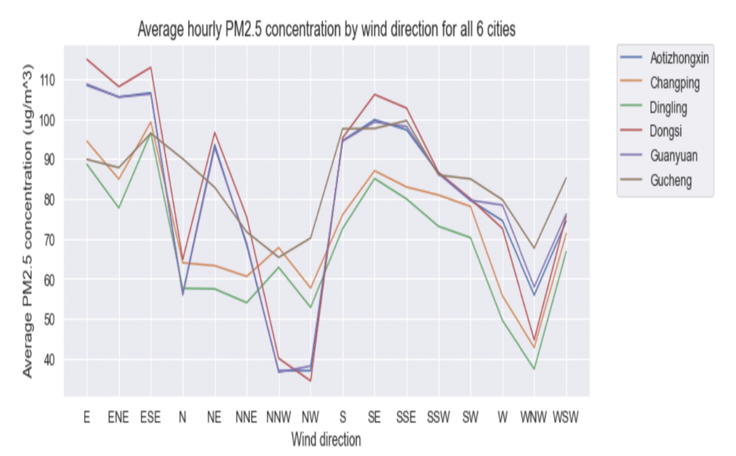
The AVG PM2.5 CONCENTRATION PER HOUR IS CALCULATED BASED ON WIND
The graph represents the average hourly recorded PM2.5 concentration in the air for all 6 cities.
The y-axis shows the average PM2.5 concentration for each wind direction.
Each line on the graph represents one of the 6 cities, and the legend on the right side of the graph shows which line corresponds to which city.
The graph shows that there is a variation in the average hourly PM2.5 concentration by wind direction for all 6 cities.
It also indicates that the concentration of PM2.5 varies depending on the wind direction for each city.

Slide 11

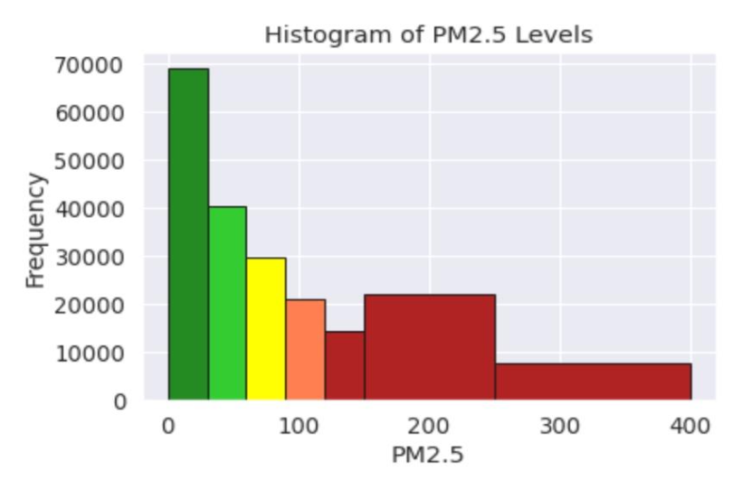
PM2.5 HISTOGRAM OF LEVELS
The data was analyzed by wind direction to understand how it affects PM2.5 levels.
A graph was created to show the average hourly PM2.5 concentration for different wind directions.
PM2.5 is on the X-axis and the frequency of observation is on the Y-axis in the histogram.
Different colors are used to depict different PM2.5 level ranges in the histogram.
The graph and histogram help to visualize and understand PM2.5 concentration in the city.

Slide 12
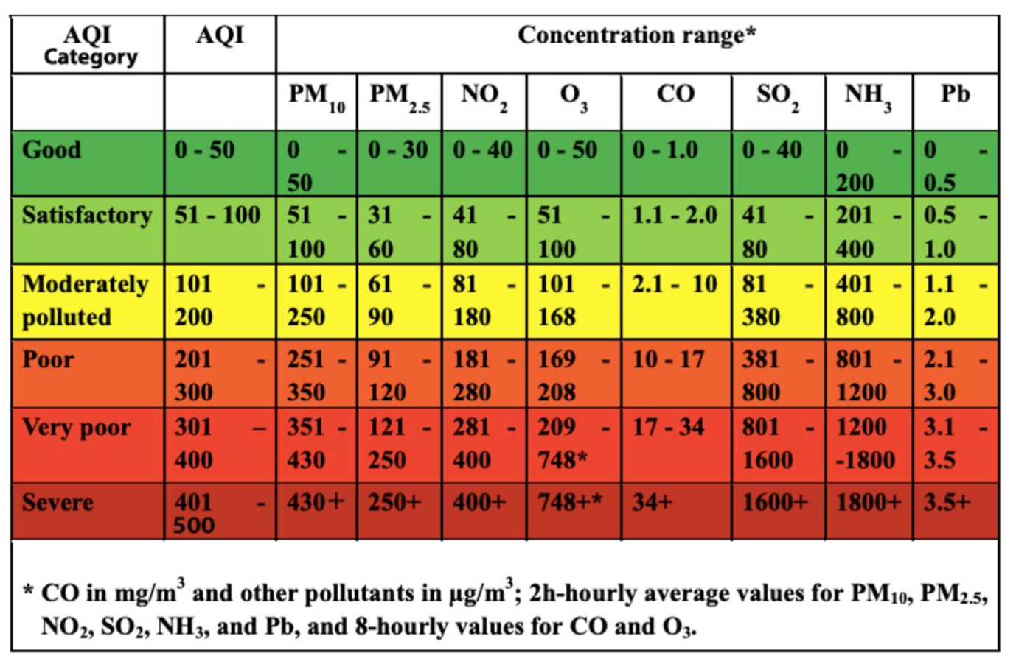
AQI INFORMATION
PM2.5 is a tiny particle that can cause air pollution.
These particles are smaller than 2.5 micrometers in diameter.
PM2.5 has been linked to health problems like asthma, heart disease, stroke, and lung cancer.
PM2.5 is measured with a device called a PM2.5 monitor or particle counter.
Other air quality indicators include ozone, nitrogen dioxide, sulfur dioxide, and carbon monoxide.
Governments and organizations monitor these indicators to assess air quality and develop policies to reduce air pollution and protect public health.

Slide 13
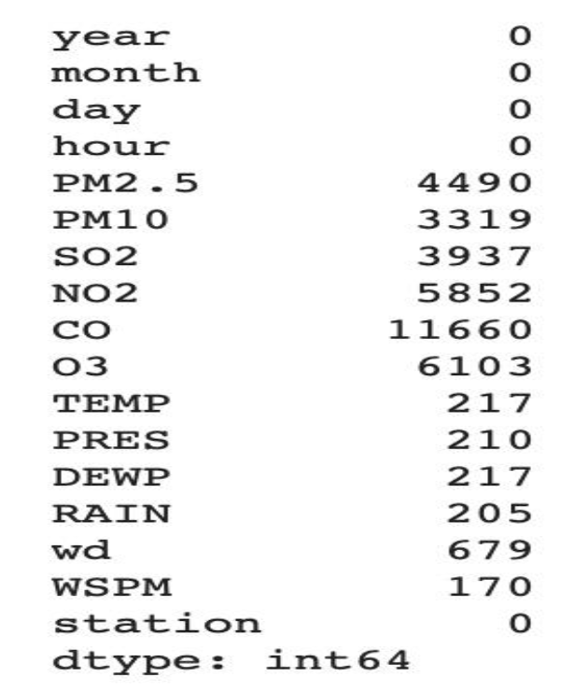
PRE-PROCESSING AND DATA CLEANING
Missing values were identified in the dataset
K-Nearest Neighbors (KNN) imputation technique was used to fill in missing values
Less relevant columns ('year', 'month', 'day' and 'hour') were dropped
Standardization was applied to scale the data to have a mean of 0 and a standard deviation of 1
This was done to ensure that all variables had the same range and size and help machine learning algorithms perform better.

Slide 14
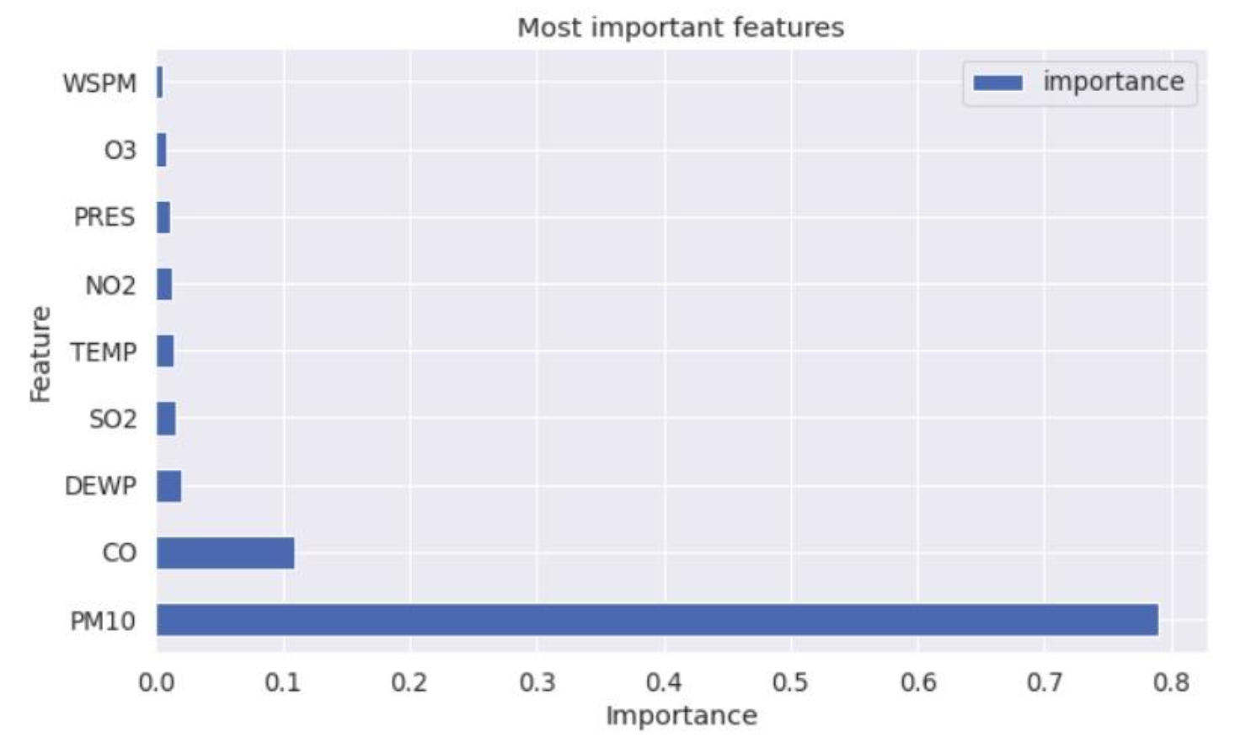
TOP 9 FEATURES
The selected features for air quality prediction were chosen after analyzing data and literature.
Important features were included and correlations were checked to avoid overfitting.
The top 9 features were identified.
The outlier handling approach was discarded as it eliminated important values for environmental sustainability.

Slide 15
PROBLEM SOLUTION
Extra Trees Regressor
This approach can reduce overfitting and improve model performance compared to individual decision trees.
MODELING
Gradient Boosting Regressor
Several regression models were developed during the project's modeling phase to predict the target feature "PM2.5."
It builds decision trees one at a time, correcting errors made by previous trees and It's less prone to overfitting than other models.
XGB Regressor
It is optimized for speed and performance and It is highly accurate and can handle large datasets with many features.

Slide 16
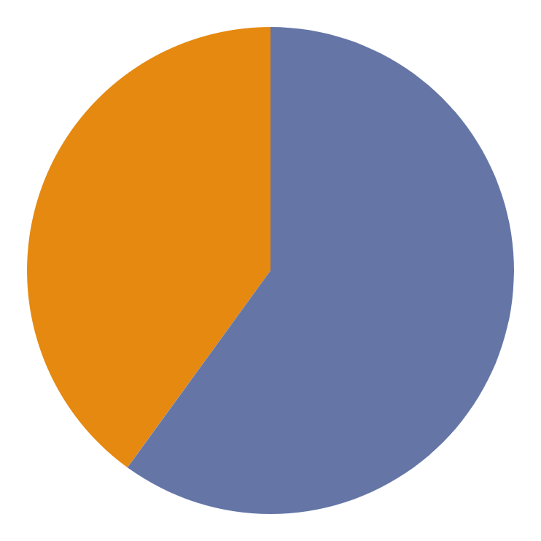
PROBLEM SOLUTION
91.7% R2 score
KNN - REGRESSOR
In KNN Regressor the prediction is based on the average of their values and is useful when the dataset is small and has few features it's adjusted R2 score is 91.7%.
90.7% R2 score
RANFOM FOREST REGRESSOR
It is a type of ensemble learning algorithm that creates decision trees and combines their predictions to make a final output. Moreover, uses large datasets. Its adjusted R2 score is 90.7%

Slide 17
EVALUATION METRICS
ROOT MEAN SQUARE ERROR (RMSE)
MEAN ABSOLUTE ERROR (MAE)
R-SQUARED (R2)
ADJUSTED R-SQUARED (ADJUSTED R2) SCORE
RMSE, MAE, Adjusted R2 score, and R2 score can be used to measure regression models.
It helps evaluate the model's performance and how well it fits the data.
A lower RMSE value indicates a better model accuracy in predicting values.
It measures the avg absolute difference btw predicted and actual values.
MAE is expressed in the same units as the data being predicted.
R2 score measures how well a model fits the data
The proportion of variance in the dependent variable (PM2.5 levels) that can be predicted by the independent variables (air quality factors).
A higher R2 score means the model is better at predicting PM2.5 levels.
It takes into account the number of independent variables in a model
It penalizes the model for adding unnecessary independent variables that don't improve its performance
Adjusted R2 is a more reliable measure of model fit than R2

Slide 18
THE EVALUATION METRICS OF ALL MODELS ARE DISPLAYED
REGRESSION MODELS | RMSE | MAE | R2 SCORE | ADJUSTED R2 SCORE
KNN | 23.1 | 13.9 | 91.7 | 91.7
EXTRA TREES | 21.7 | 13.9 | 92.7 | 92.7
LGB | 20.3 | 12.8 | 93.6 | 93.6

Slide 19
THE EVALUATION METRICS OF ALL MODELS ARE DISPLAYED
REGRESSION MODELS | RMSE | MAE | R2 SCORE | ADJUSTED R2 SCORE
RANDOM FOREST | 24.4 | 15.7 | 90.7 | 90.7
GRADIENT BOOSTING | 24.2 | 15.4 | 90.9 | 90.8
XGB | 25.3 | 16.2 | 90.0 | 90.0

Slide 20
REDUCING AIR POLLUTION
The table compares different models for predicting PM2.5 in which the Extra Trees Regressor performs the best with a R2 score of almost 94%. Overall, this is a significant improvement compared to other models.
Jupyter Notebook was used for implementing the models, Sklearn was used for preprocessing of data where the matplotlib and Seaborn were used for visualizations, and sklearn models were used for the comparison of performance
MODEL COMPARISON
LANGUAGES USED
TOOLS USED
The entire project was completed using Python and various Python libraries were used.

Slide 21
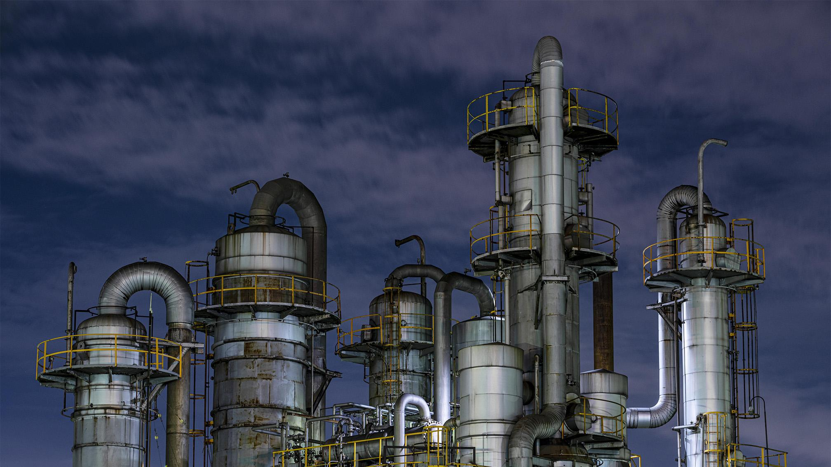
DEMO

Slide 22
CONCLUSION
The conclusion of the analysis is that historical data can be used to create a model that can predict PM 2.5 levels in the future, and that this information can be used to make impactful decisions related to air quality and the health of citizens. The use of AI and Machine Learning in this field has proven to be beneficial and can aid lawmakers in preventing potential air quality emergencies.

Slide 23
THANKS!
DO YOU HAVE ANY QUESTIONS?

Slide 24



OUR TEAM
Utsav
Shubham Hruthik

Slide 25


OUR TEAM
Maria
Sahanti

